Slide 1
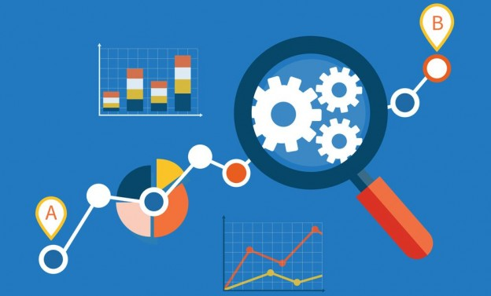
Diwali Sales Data Analysis Using Python
Arnab Samanta
17-07-2024

Slide 2

OUTLINE
Introduction
Methodology
Results
Visualization-charts
Discussion
Findings
Conclusion

Slide 3

Introduction
About:
Diwali Sales Data Analysis
Objective:
Analyse The Sales Data
Make Some Insightful Comments On Sales By Observing The Data

Slide 4

Methodology
Business Problem Understanding
Data Collection
Client has provided historical data in csv file
Link: https://drive.google.com/file/d/1mGY1doT8RRTgIS0eZsiexHOjUIel9pvo/view?usp=drive_link
Data Pre-processing
Data Profiling
Data Cleaning
Data Consistency
Data Formatting
Outlier Detection & Removal
Exploratory Data Analysis

Slide 5
Results
Visualization (charts)
Gender wise Sales Analysis - page 6
Marriage Status Wise Sales Analysis - page 7
Age Group Wise Sales Analysis - page 8
Occupation Wise Sales Analysis - page 9
Product Category Wise Sales Analysis - page 10
Product ID Wise Sales Analysis - page 11
State Wise Sales Analysis - page 12

Slide 6
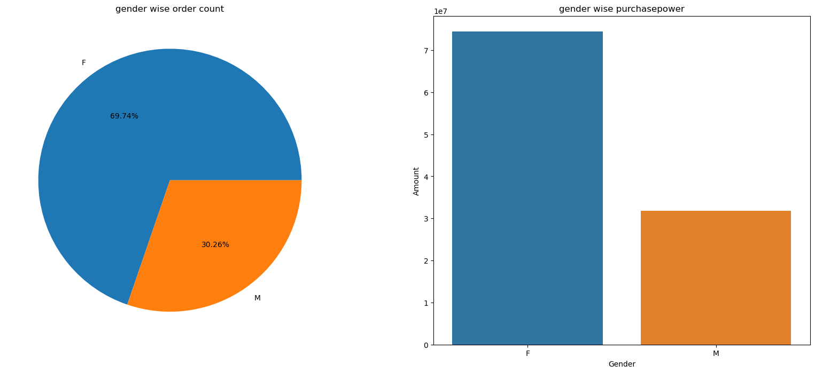
Gender wise Sales Analysis

Slide 7
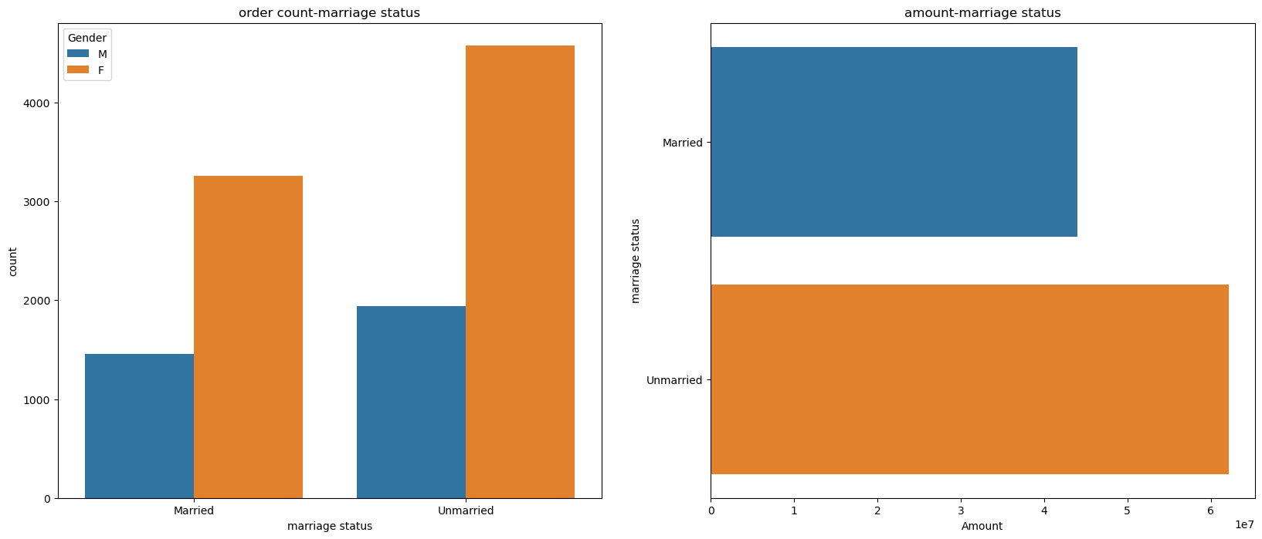
Marriage Status Wise Sales Analysis

Slide 8
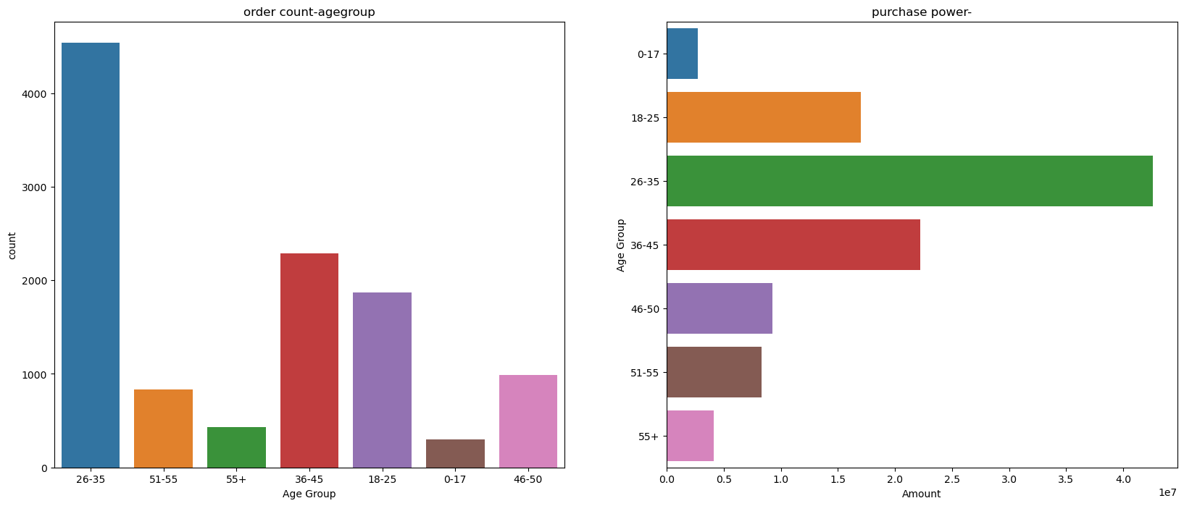
Age Group Wise Sales Analysis

Slide 9
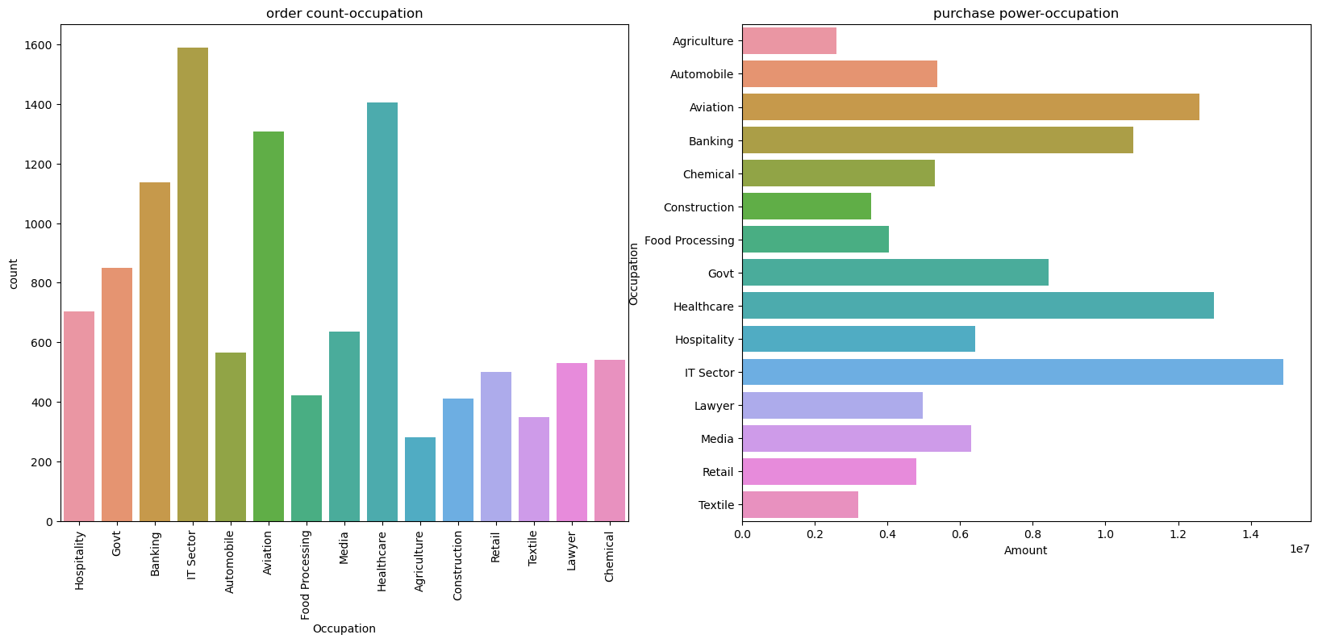
Occupation Wise Sales Analysis

Slide 10
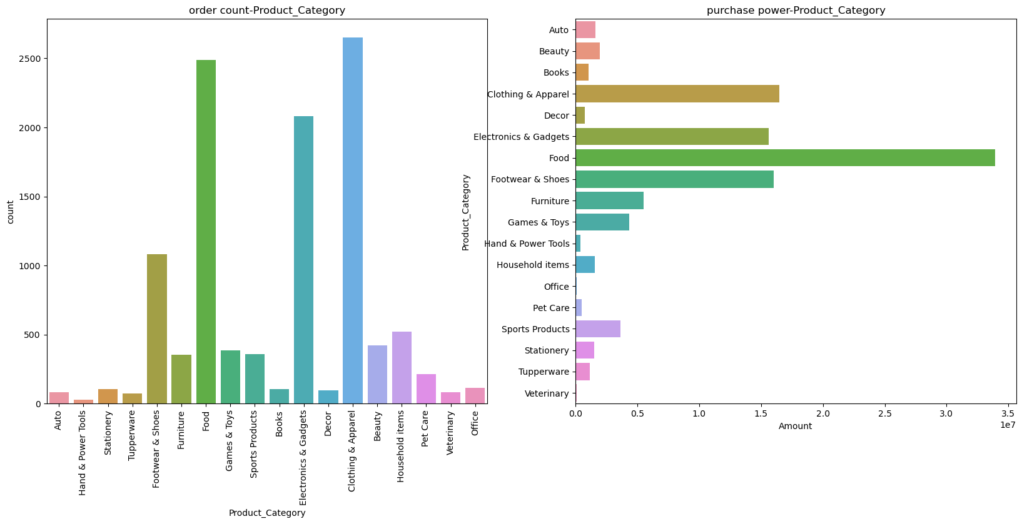
Product Category Wise Sales Analysis

Slide 11
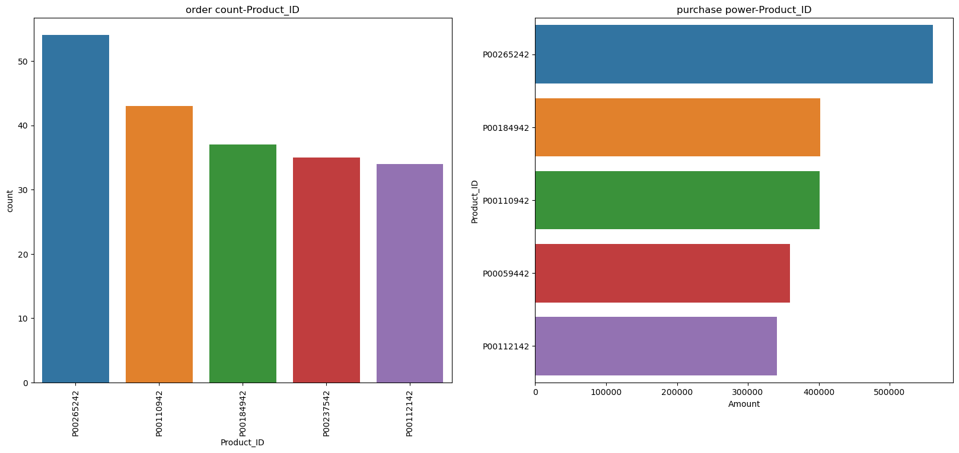
Product ID Wise Sales Analysis

Slide 12
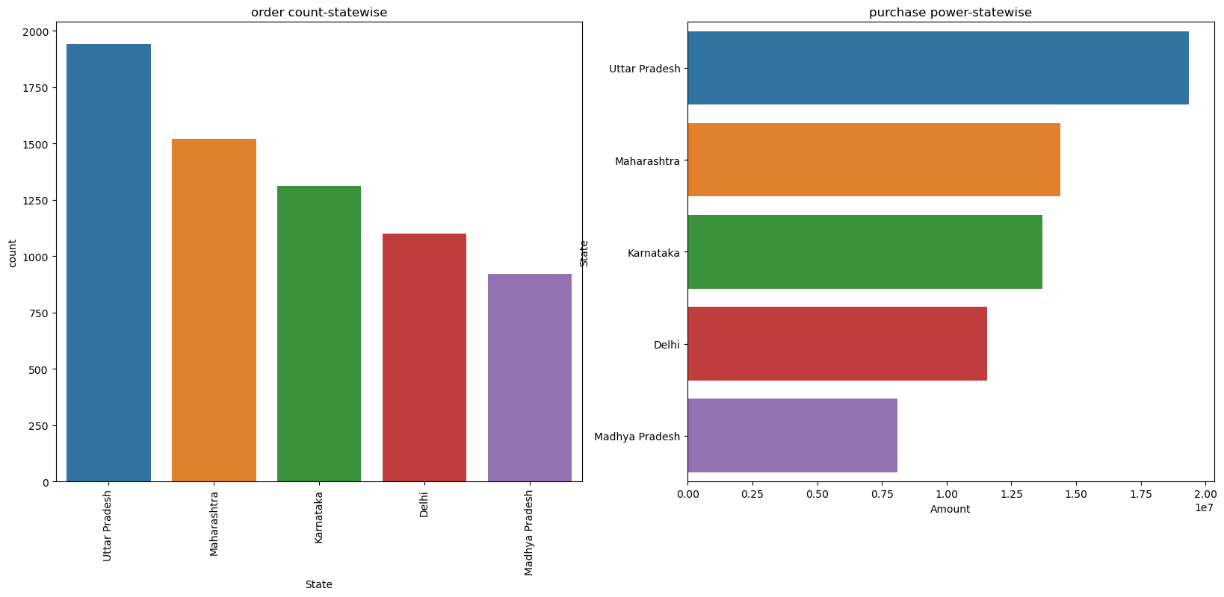
State Wise Sales Analysis

Slide 13
Discussion
Findings:
Female Generally Places More Order Compare to Male
Unmarried Females Are Spending More Compare To Married Females And Males
26-35 Age Group People Buy More Compare To Other Age Groups
IT Sector's People Order More And Pay More Amount Than Other Occupations
The Food category generates the highest revenue despite a lower order count, compared to Clothing & Apparel, which leads in order count but not in total amount spent.
Product ID P00265242 is the top performer in both order count and total amount spent.
Uttar Pradesh and Maharashtra are the top states in terms of order count and total amount spent.

Slide 14
Conclusion:
Young adults aged (26-35) women shop the most compared to other age groups.
Unmarried women spend more than married women and men. This shows different spending habits based on marital status.
People in the IT sector shop more and spend more per purchase compared to others. This could be due to higher salaries or preferences. Client can increase this by offering tech-related products or exclusive deals to this audience.
Food items bring in more money per purchase despite fewer orders. Clothes are ordered more often but don't bring in as much money per sale. Client should optimize product mix and pricing strategies across categories to maximize revenue and profitability.
Product ID P00265242 is the top performer in both order count and total amount spent, indicating high consumer demand and spending. Client should analyze its success factors and replicate strategies for other products to get similar results.
We can see a strong buying habits in Uttar Pradesh and Maharashtra, indicating strong consumer markets.
Understanding these trends helps businesses cater better to their customers. They can focus on products and strategies that appeal most to different age groups, genders, job sectors, and regions to maximize sales and customer satisfaction

